Slide 1
Design Presentation
Hannah, Mohamed, Miah, Binod, Faleh, Hamayun

Slide 2
What is our app?
Tunel
Help service
Improving PAL service
Helping rather than making someone do the work
Free service
Notes:
Miah

Slide 3
Research
PAL scheme
In house solution
Face to face help
Once a week session
Forum - Stack overflow
Variety of answers
Rating system for answers
Overflow of information
Repetitive questions
Uber
Simple UI
Profile security
Blackboard forum
Professional answer
Student help
In house solution
Web based forum
No notifications
Notes:
Miah

Slide 4
Demographic
Brunel students (computer science for now)
All course levels
GTA
PAL
Students
Students
PAL
Students
Notes:
Miah

Slide 5
Why use the app?
Students:
More convenient to get help on computer science related topics and projects.
In house solution
GTA/PAL:
Awards system
Feedback & rating system
Meeting verification system
Notes:
Hamayun

Slide 6
App Features
Two-way rating system
Award system
Booking system
Forum
Profile system
Limit choice for location meeting
Introduction video
Employee privileges (Hierarchy)
Sign up using Brunel email ID
Notifications
Notes:
Binod

Slide 7
App Design

Slide 8
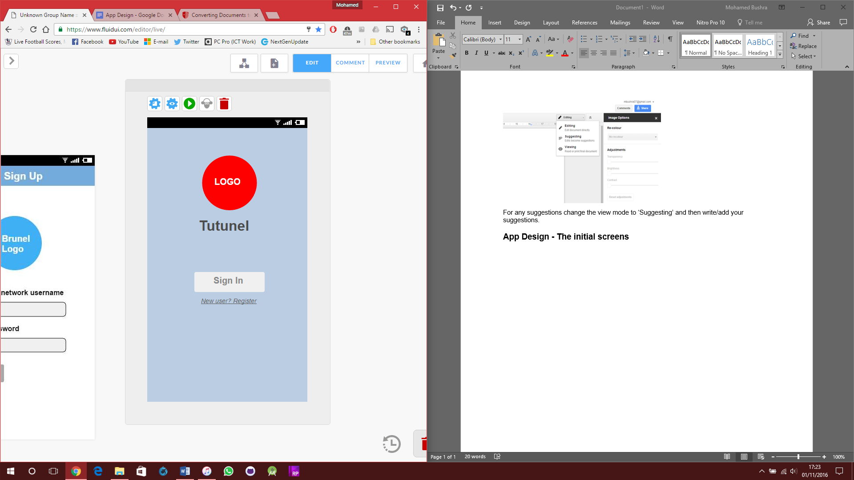
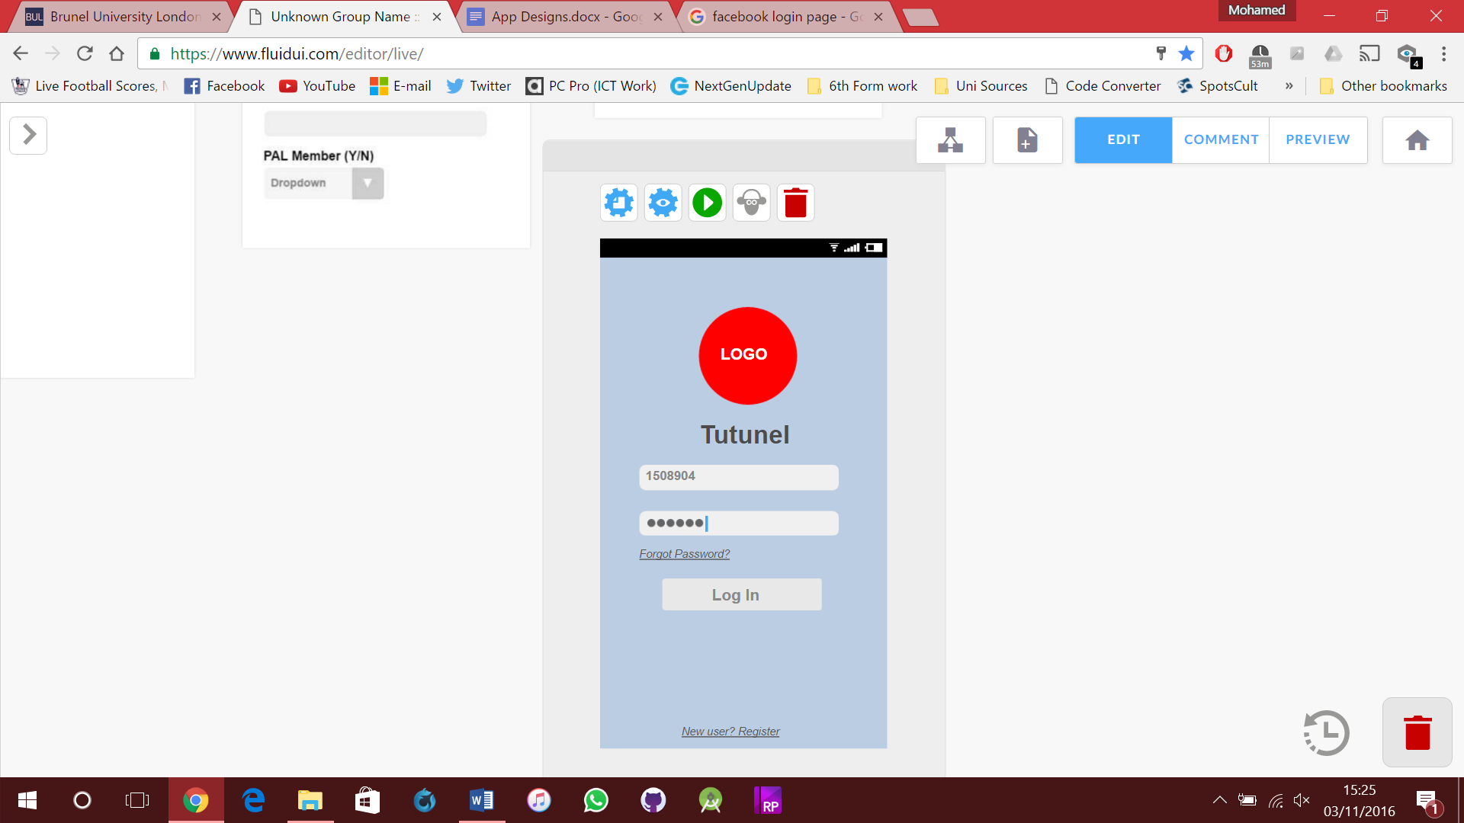
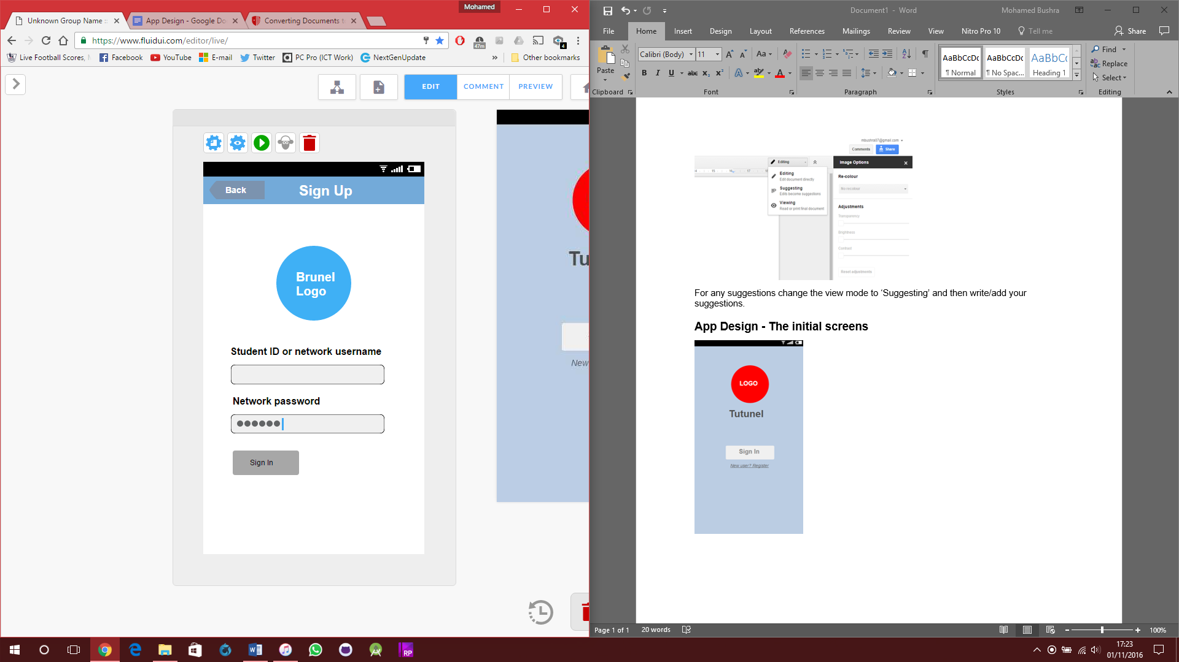
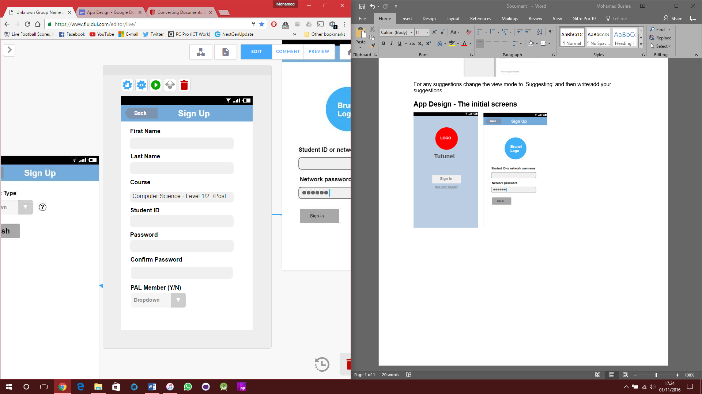
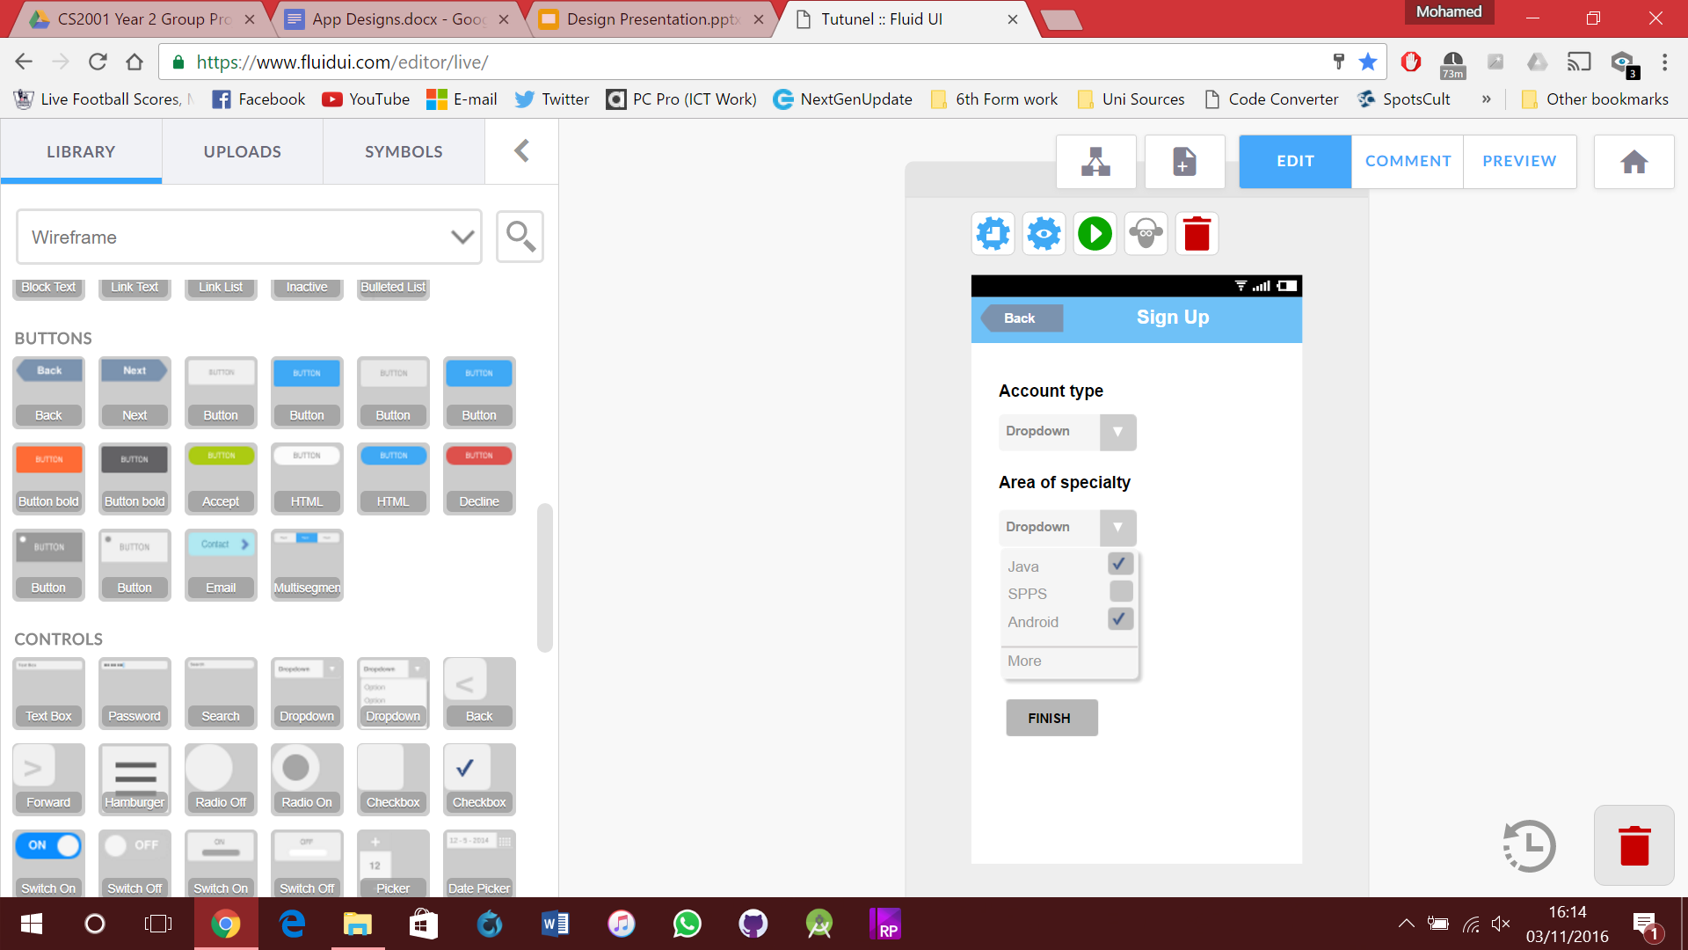
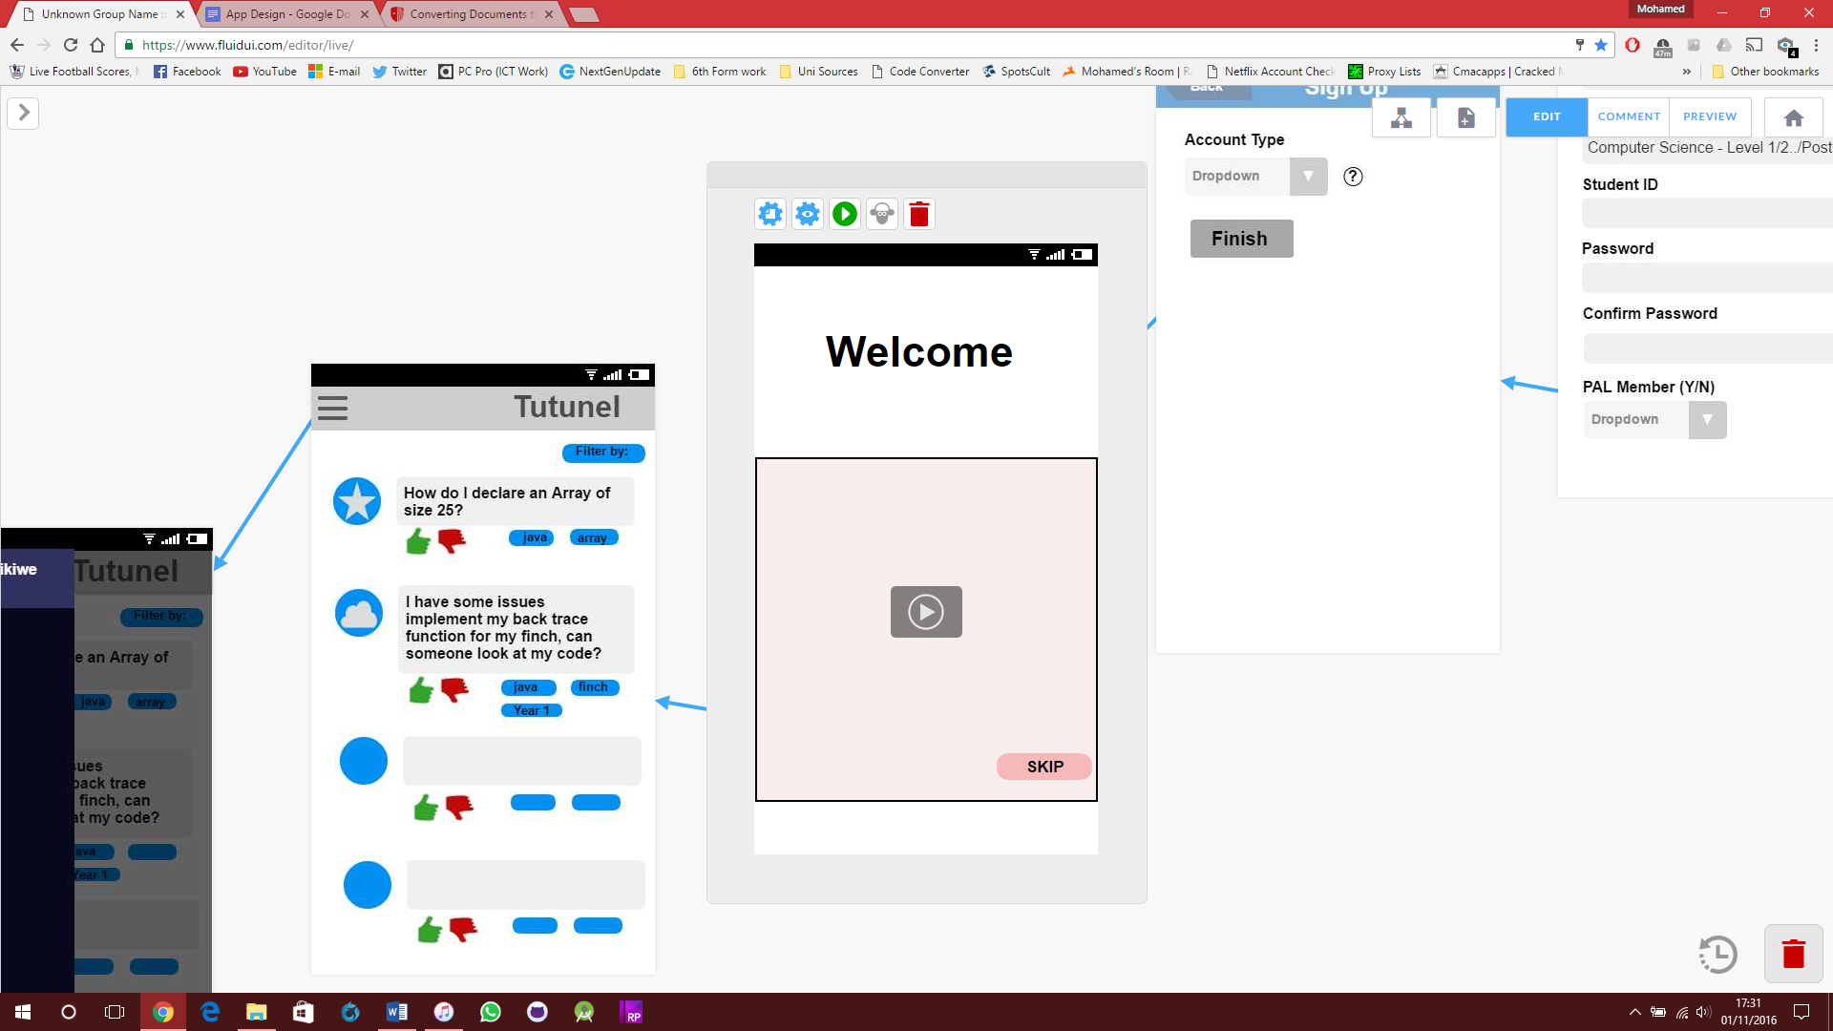
Initial Screens
Notes:
Mo
1st screen = Splash screen, user can sign-in or sign-up/register.
2nd screen = Is the sign-in screen, user can still sign-up via the link at the bottom or recover password.
3rd screen = Brunel portal where the user needs to validate that they’re a Brunel student.
4th and 5th = These are the sign-up forms that the user needs to complete.

Slide 9
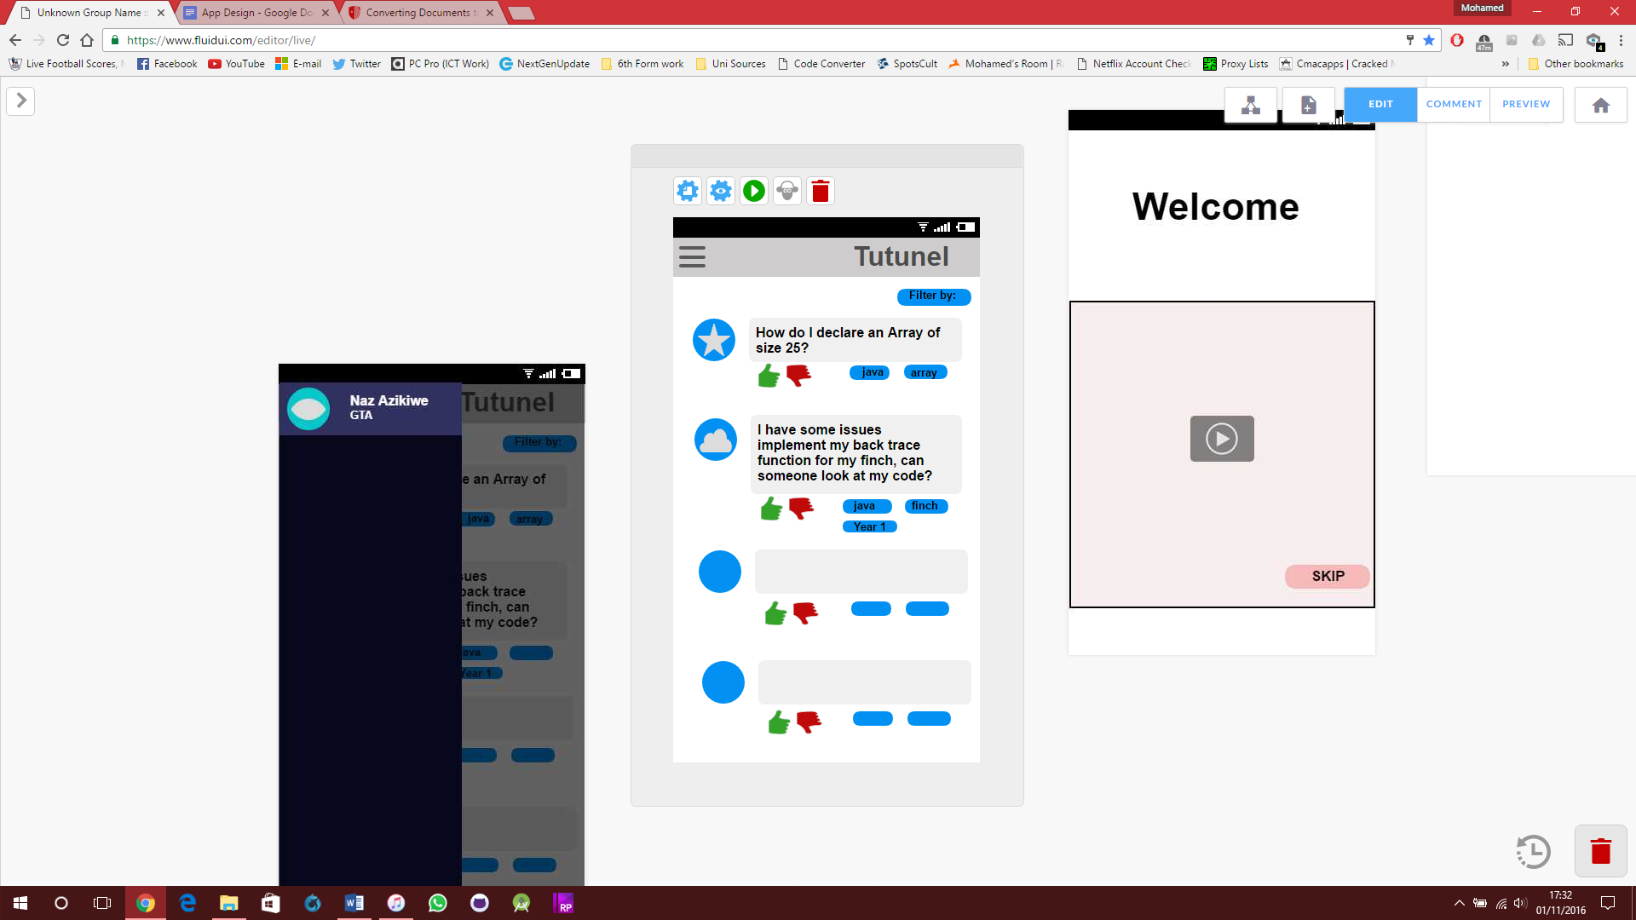
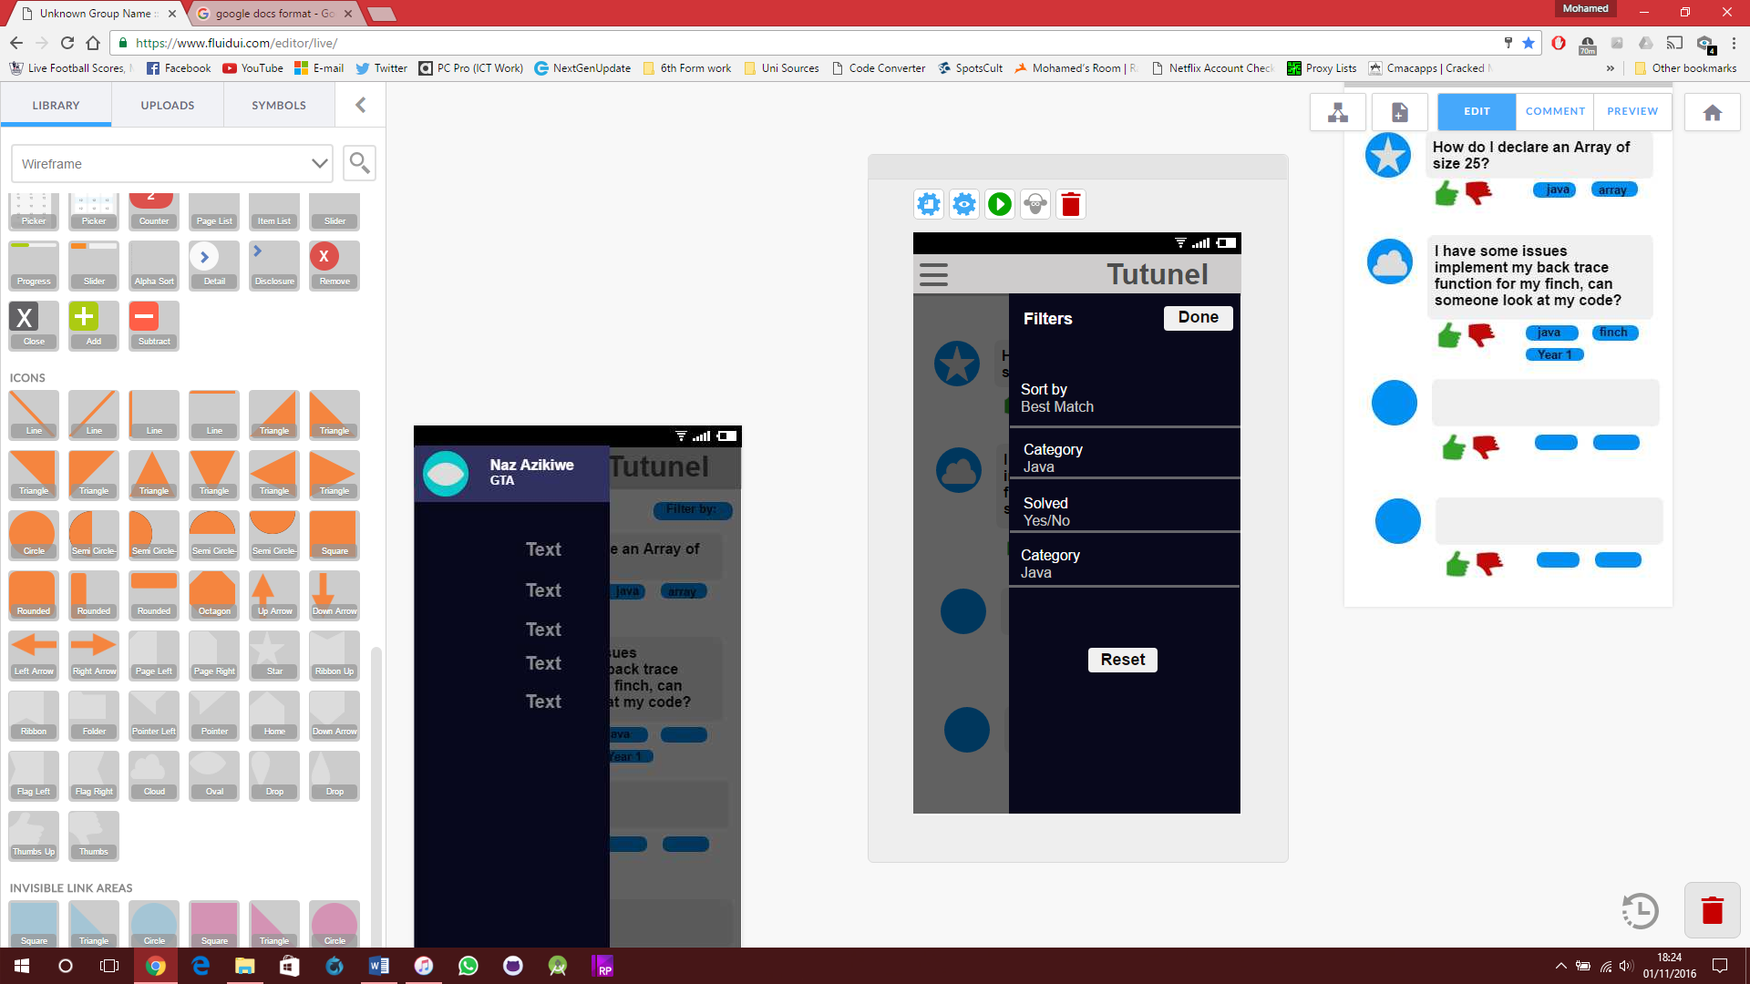
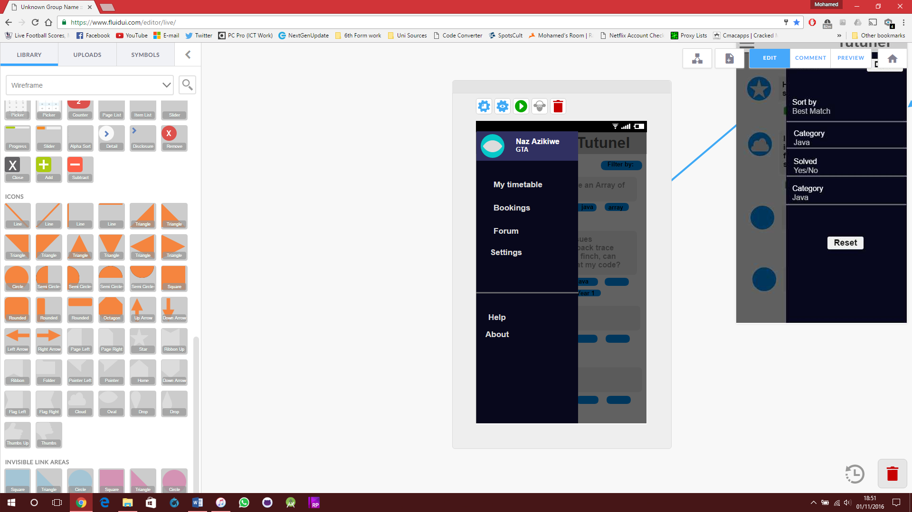
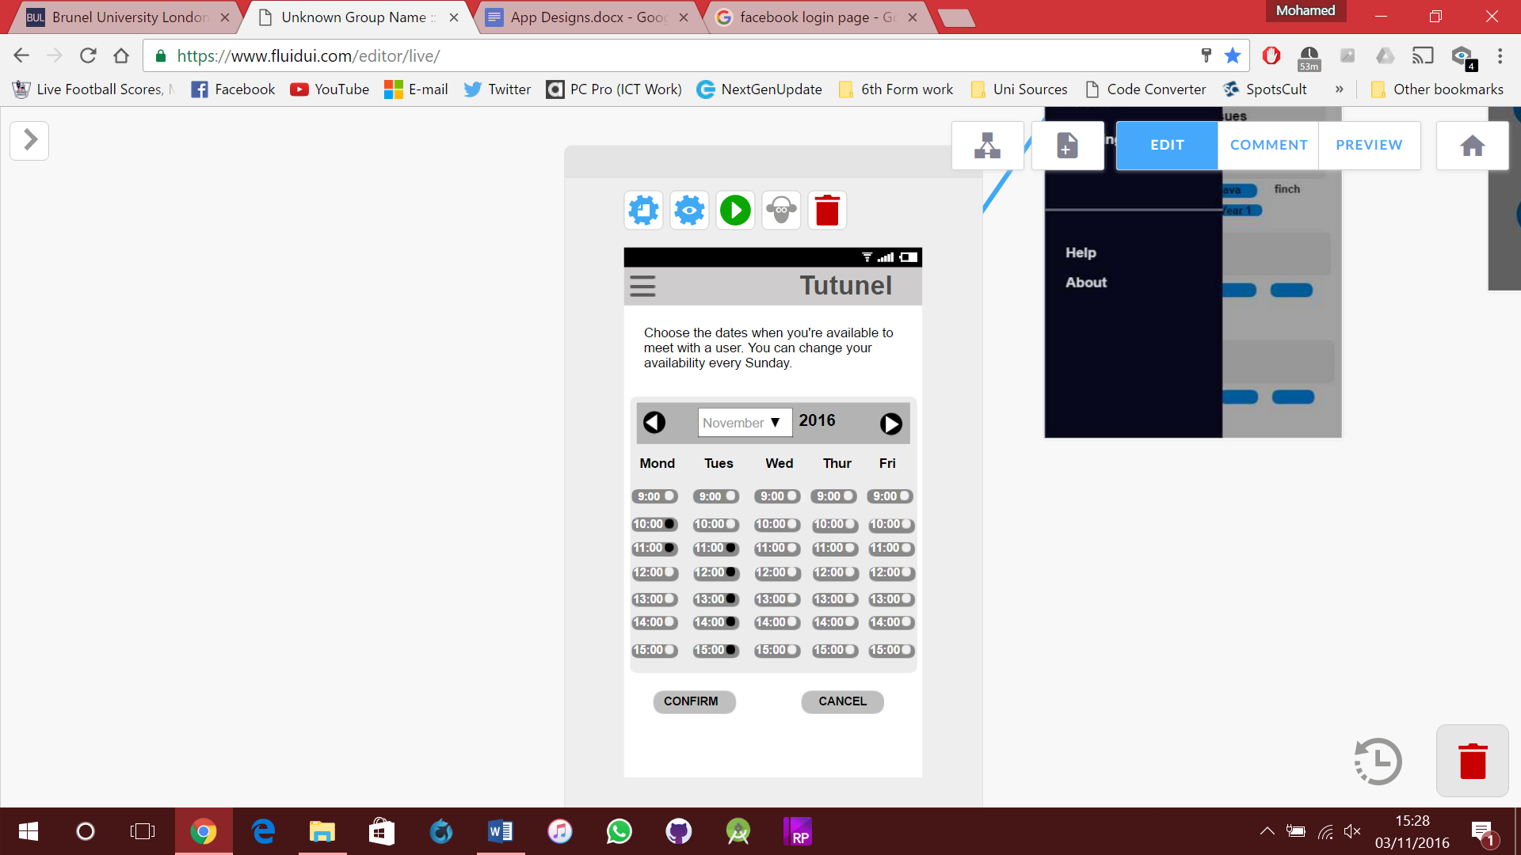
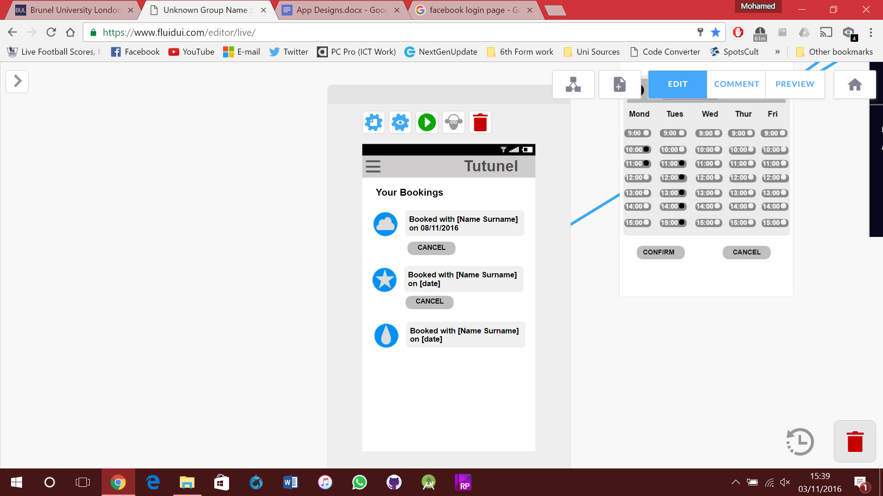
Notes:
Mo – GTA page
6th screen = User is shown a video tutorial of the app, they can always skip.
7th and 8th screen = The GTA/PAL member is shown the forum with user questions, they can filter the questions.
9th and 10th screen = The menu bar with some categories, then the user can determine his availability to meet 1-1 with a user who needs extra help

Slide 10
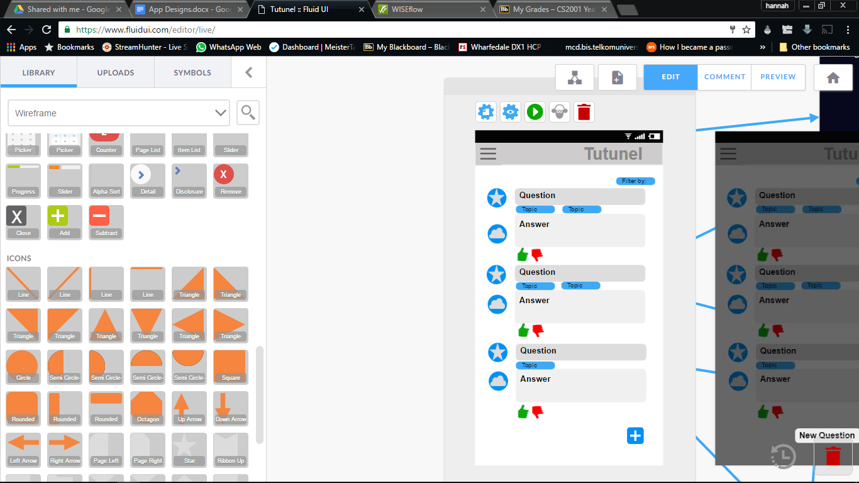
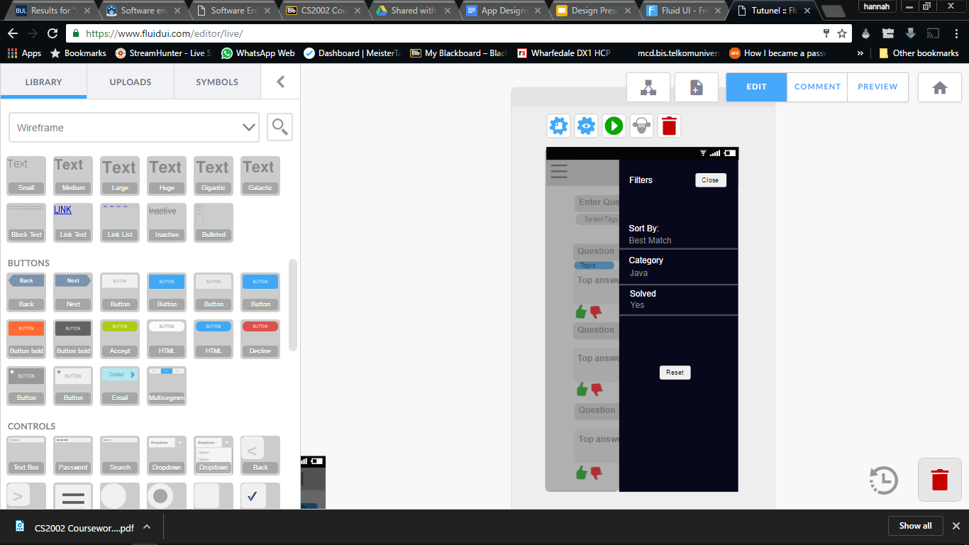
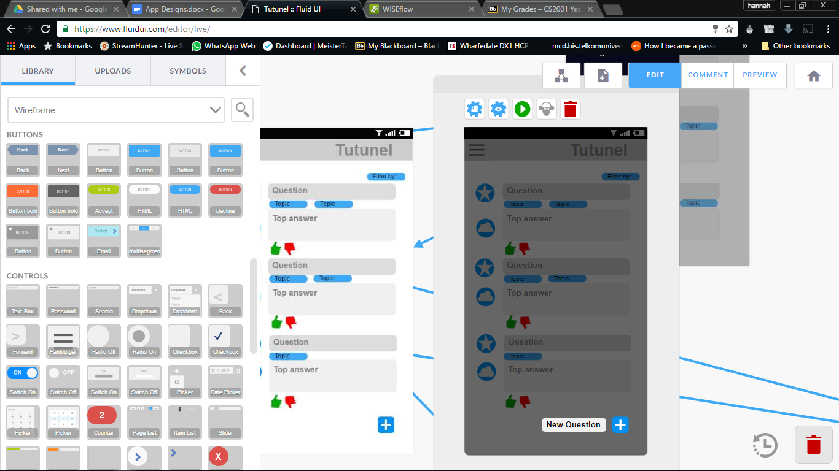
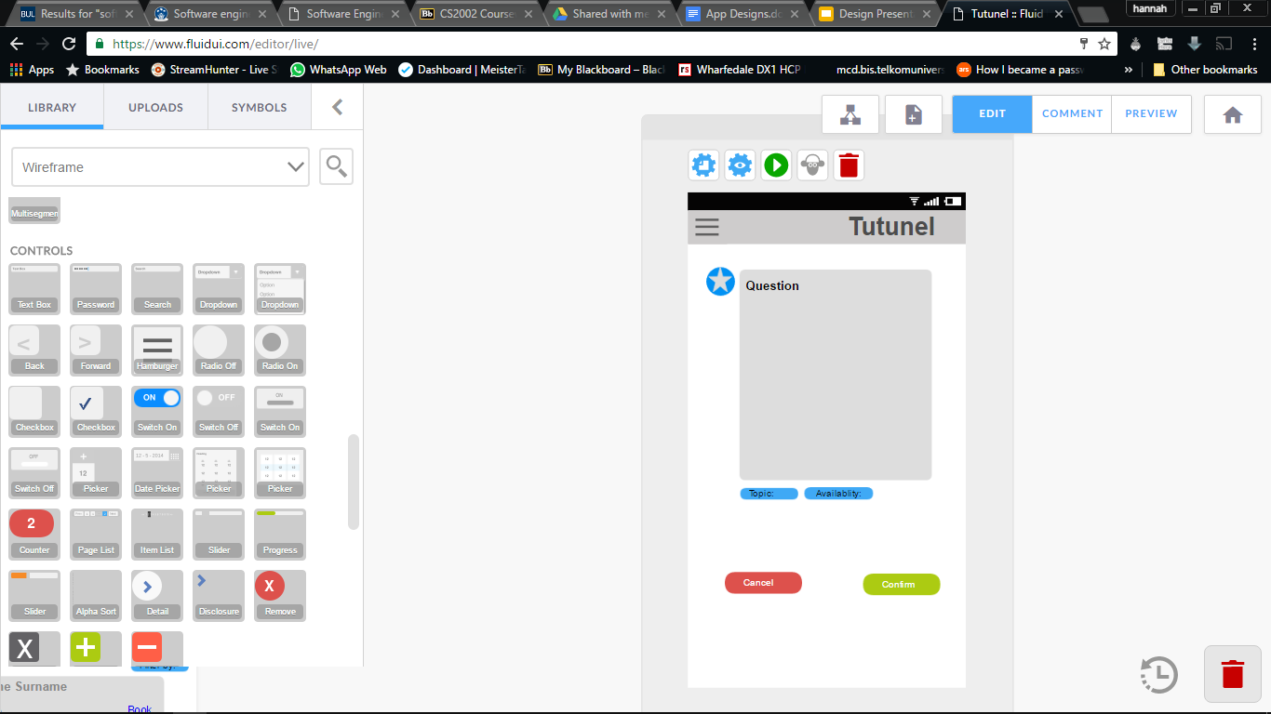
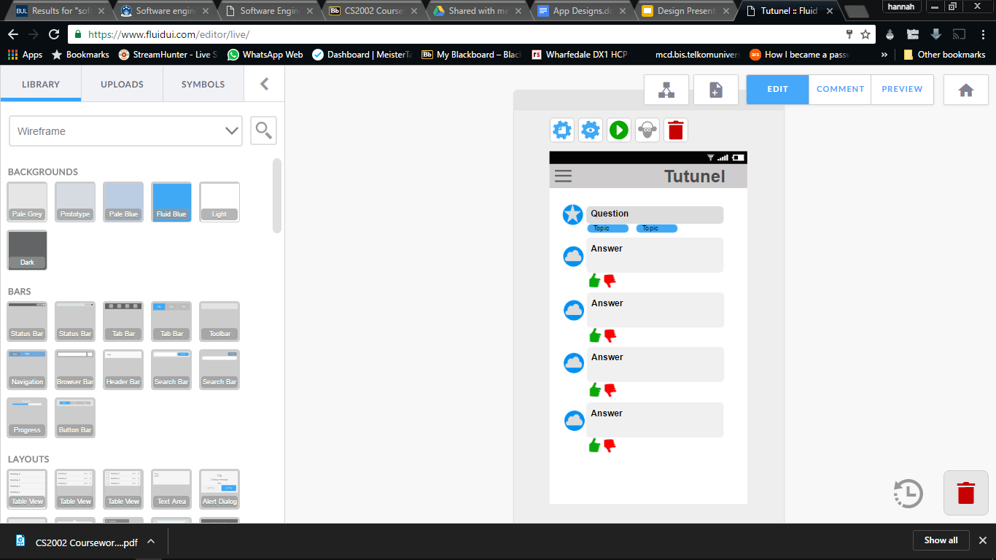
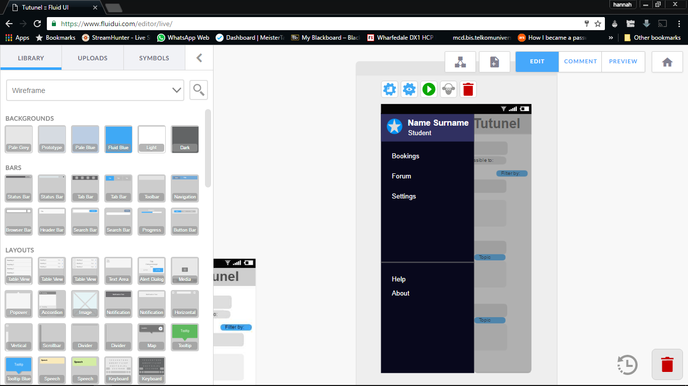
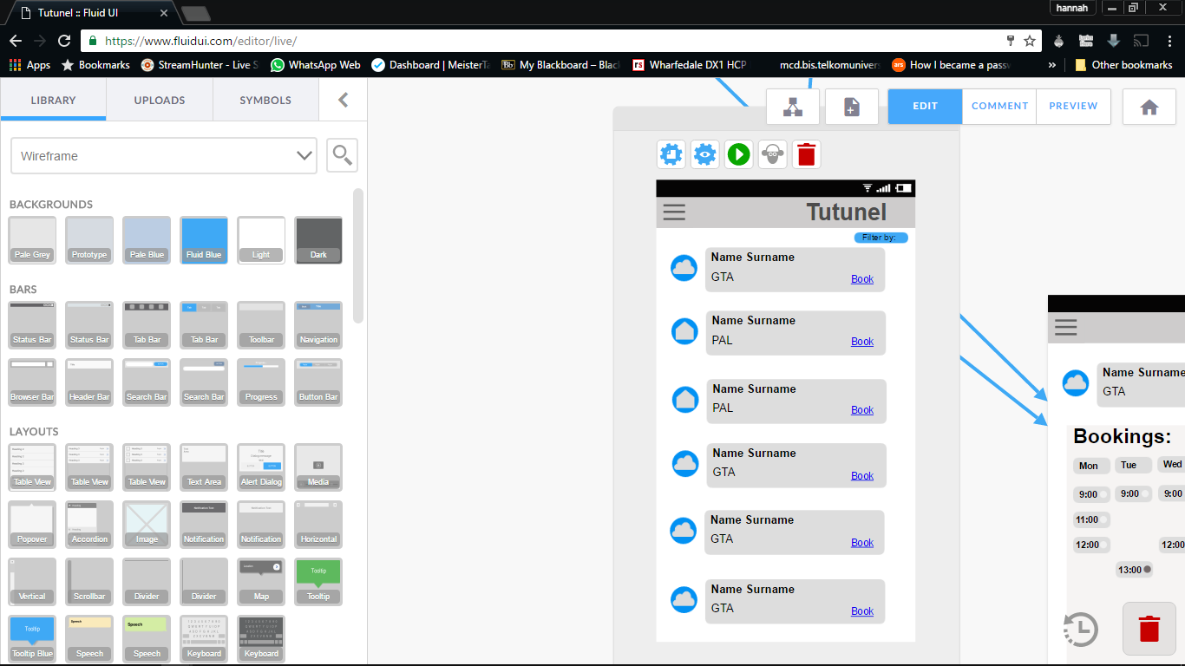
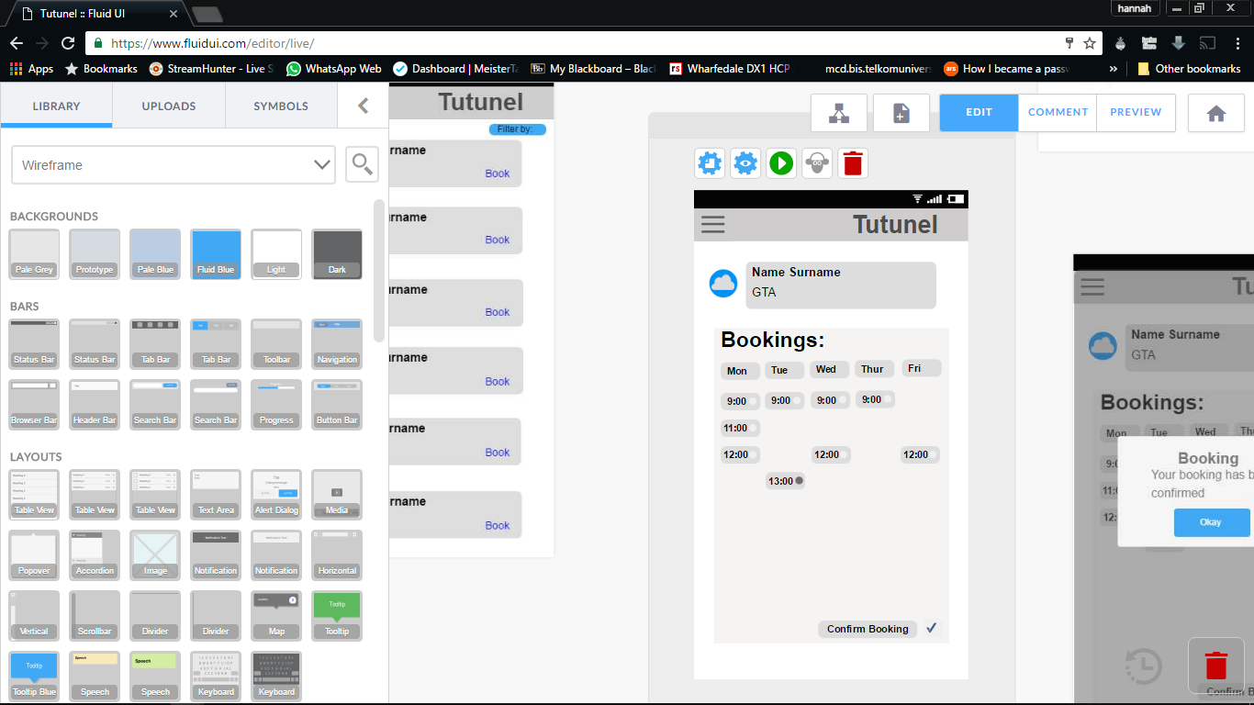
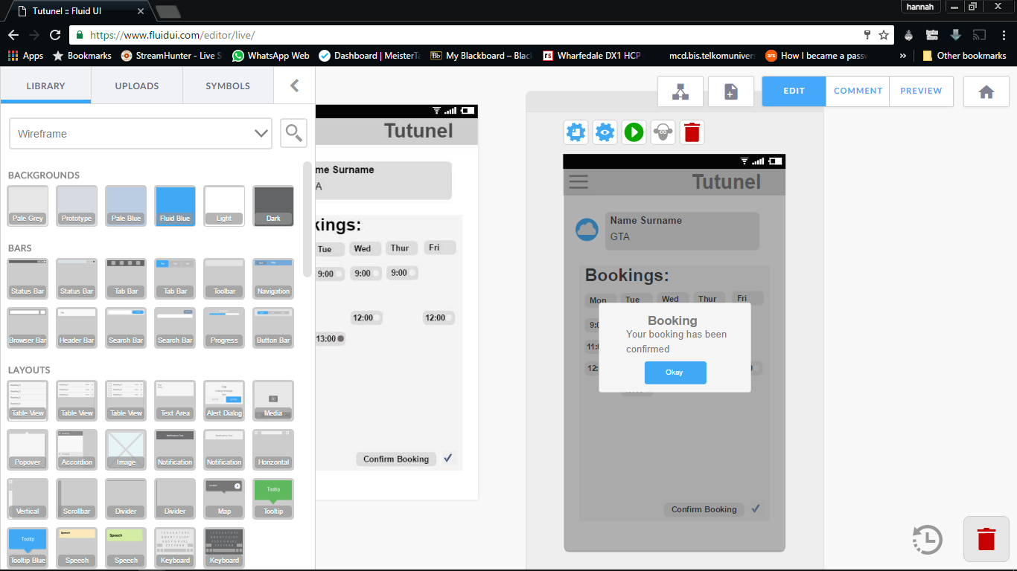
Notes:
Page 1: The main screen user sees. Has questions displayed on it. Can filter questions, automatically shows their questions first.
Page 2: Filters, have sort by: best match(theirs first), most recent, most answers.
Page 3: New question
Page 4: New question page. Add the appropriate topics, select who you want to see question, confirm or cancel.
Page 5: Individual questions with all their answers, so in more detail.
Page 6: Menu bar, forum takes back to first page, bookings takes you to page 7.
Page 7: GTA to book filters will be module basis.
Page 8: Booking times. Also access this page by clicking on picture of GTA/PAL who have answered a question.
Page 9: Confirmed booking.

Slide 11


Behind the scenes The Android Database: SQLite
SQLite: The standard Android Database engine
Self-contained,
Serverless,
Zero-configuration
Notes:
So what my fellow students just illustrated was the application interface. You might be wondering what is behind the scenes? So I will start with the database system that we will be using.

Slide 12
Behind the scenes The Android Database: SQLite
SQLite: Other advantages
It supports dynamic typing (types are assigned to values, rather than to columns)
Full-text search
Single-writer/multiple-reader access
stores each database as a single disk file in a cross-platform format
Supports ACID transactions
Notes:
It supports dynamic typing (types are assigned to values, rather than to columns), transactions, full-text search, single-writer/multiple-reader access, efficient range queries (useful when storing geographical data), and shared caching (across connections opened by a single thread to the same database).
SQLite stores each database as a single disk file in a cross-platform format. This implies that you can create an SQLite database on one machine and then use it on another machine with an entirely different architecture by simply copying the corresponding file.
The authors of SQLite believe that it is “the most widely deployed SQL database”. Bindings for SQLite are available in most mainstream programming languages. SQLite is also included in both iPhone and Android operating systems.
A: Atomicity requires that each transaction be "all or nothing"
C: The consistency property ensures that any transaction will bring the database from one valid state to another.
I: The isolation property ensures that the concurrent execution of transactions results in a system state that would be obtained if transactions were executed serially, i.e., one after the other.
D: The durability property ensures that once a transaction has been committed, it will remain so, even in the event of power loss, crashes, or errors.

Slide 13
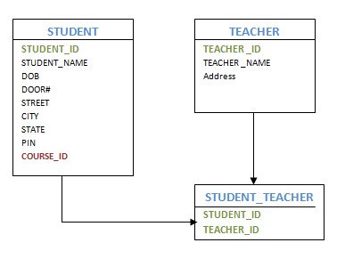
Searching using SQLite
SQL Queries
SQL Queries : CRUDE support
public Cursor query ( String table, String[] columns, String selection, String[] selectionArgs, String groupBy, String having, String orderBy, String limit)
Notes:
SQLiteDatabase has methods to create, delete, execute SQL commands, and perform other common database management tasks.
To query a given table and return a Cursor object over the result set you can use the following method. Parameters table
The table name to compile the query against.
columns
A list of which columns to return. Passing null will return all columns, which is discouraged to prevent reading data from storage that isn't going to be used.
selection
A filter declaring which rows to return, formatted as an SQL WHERE clause (excluding the WHERE itself). Passing null will return all rows for the given table.
selectionArgs
You may include ?s in selection, which will be replaced by the values from selectionArgs, in order that they appear in the selection. The values will be bound as Strings.
groupBy
A filter declaring how to group rows, formatted as an SQL GROUP BY clause (excluding the GROUP BY itself). Passing null will cause the rows to not be grouped.
having
A filter declare which row groups to include in the cursor, if row grouping is being used, formatted as an SQL HAVING clause (excluding the HAVING itself). Passing null will cause all row groups to be included, and is required when row grouping is not being used.
orderBy
How to order the rows, formatted as an SQL ORDER BY clause (excluding the ORDER BY itself). Passing null will use the default sort order, which may be unordered.
limit
Limits the number of rows returned by the query, formatted as LIMIT clause. Passing null denotes no LIMIT clause.
Returns A Cursor object, which is positioned before the first entry. Note that Cursors are not synchronized

Slide 14
Searching using SQLite
Full Text Search
Full Text Search Modules: FTS3 and FTS4
Allow users to create special tables with a built-in full-text index
Users can efficiently query the database for all rows that contain one or more words (tokens)
Notes:
But it goes beyond that since SQLite allows for Full text search.

Slide 15
What’s next?

